Slide 1


JICA-INACON PROJECT
Outcomes of LBE Research
National University of Battambang
Faculty of Science and Technology
PI: Mr. ENG Titya
2025 -2026

Slide 2
Introduction of Research
Topic:
Budget: $7,500
Period:

Slide 3








LBE Research Members and Assignments
Mr. ENG Titya, PI
Mrs. CHAN Sokha, Co-PI
Mr. HORN Samart, Co-PI
Mr. HAM Heng, Lecturer
Mr. HUON Sophy, Lecturer
Mr. SAK Mengseu. Master Y1
Mr. SINTHA Monthy. Bachelor Y3
Mr. SINTHA Monthy. Bachelor Y2

Slide 4


Team Member
Mr. ENG Titya, PI
Mrs. CHAN Sokha, Co-PI
Mr. HORN Samart, Co-PI
Mr. HAM Heng, Lecturer
Mr. HUON Sophy, Lecturer
Mr. SAK Mengseu. Master Y1
Mr. SINTHA Monthy. Bachelor Y3
Mr. SINTHA Monthy. Bachelor Y2

Slide 5
LBE Research Members and Assignments

Slide 6
Introduction
Plant Cell Technology (2024)
Objective:
Design a RAG-enabled LLM framework for Moodle assessment.
Evaluate question quality, retrieval effectiveness, and performance.

Slide 7
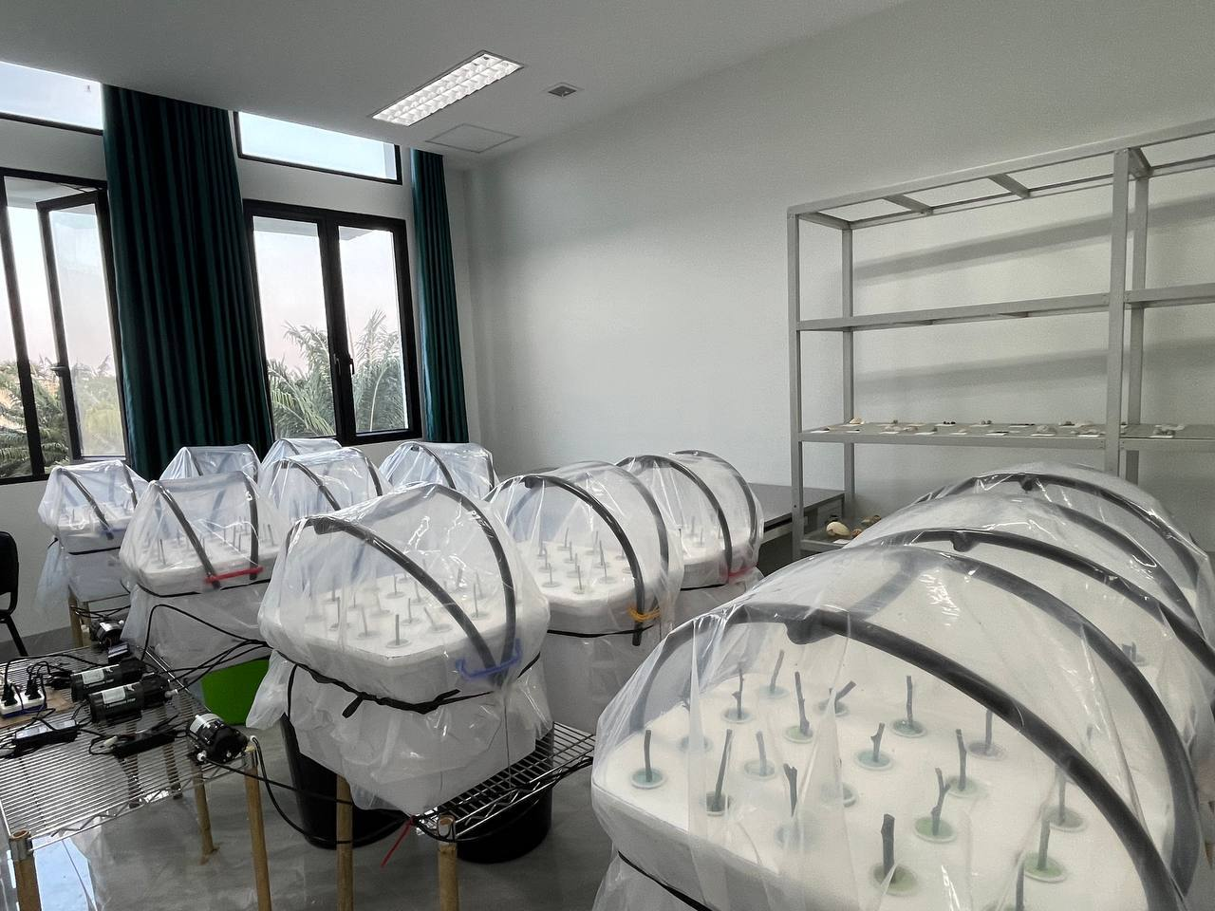
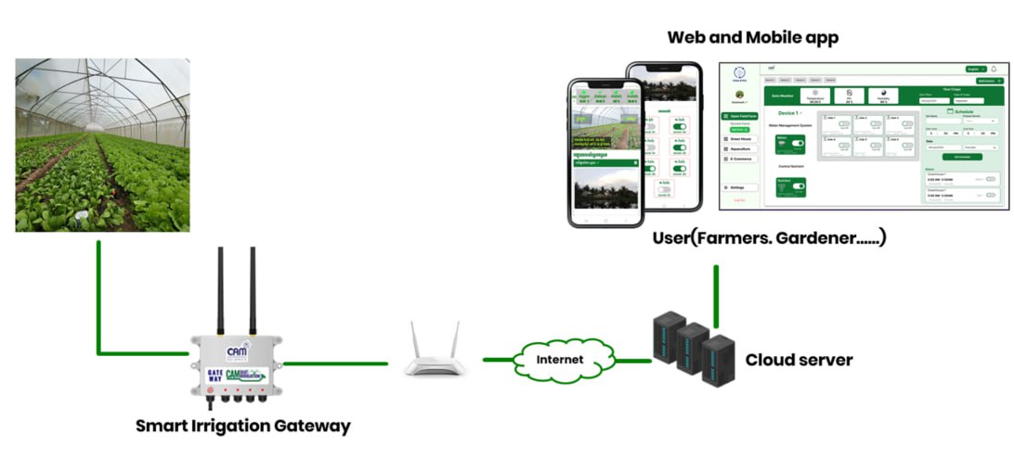
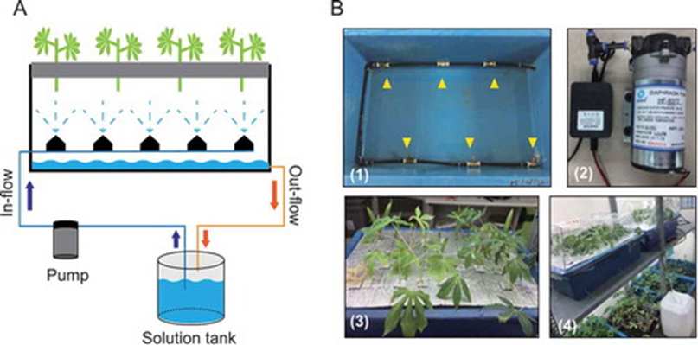
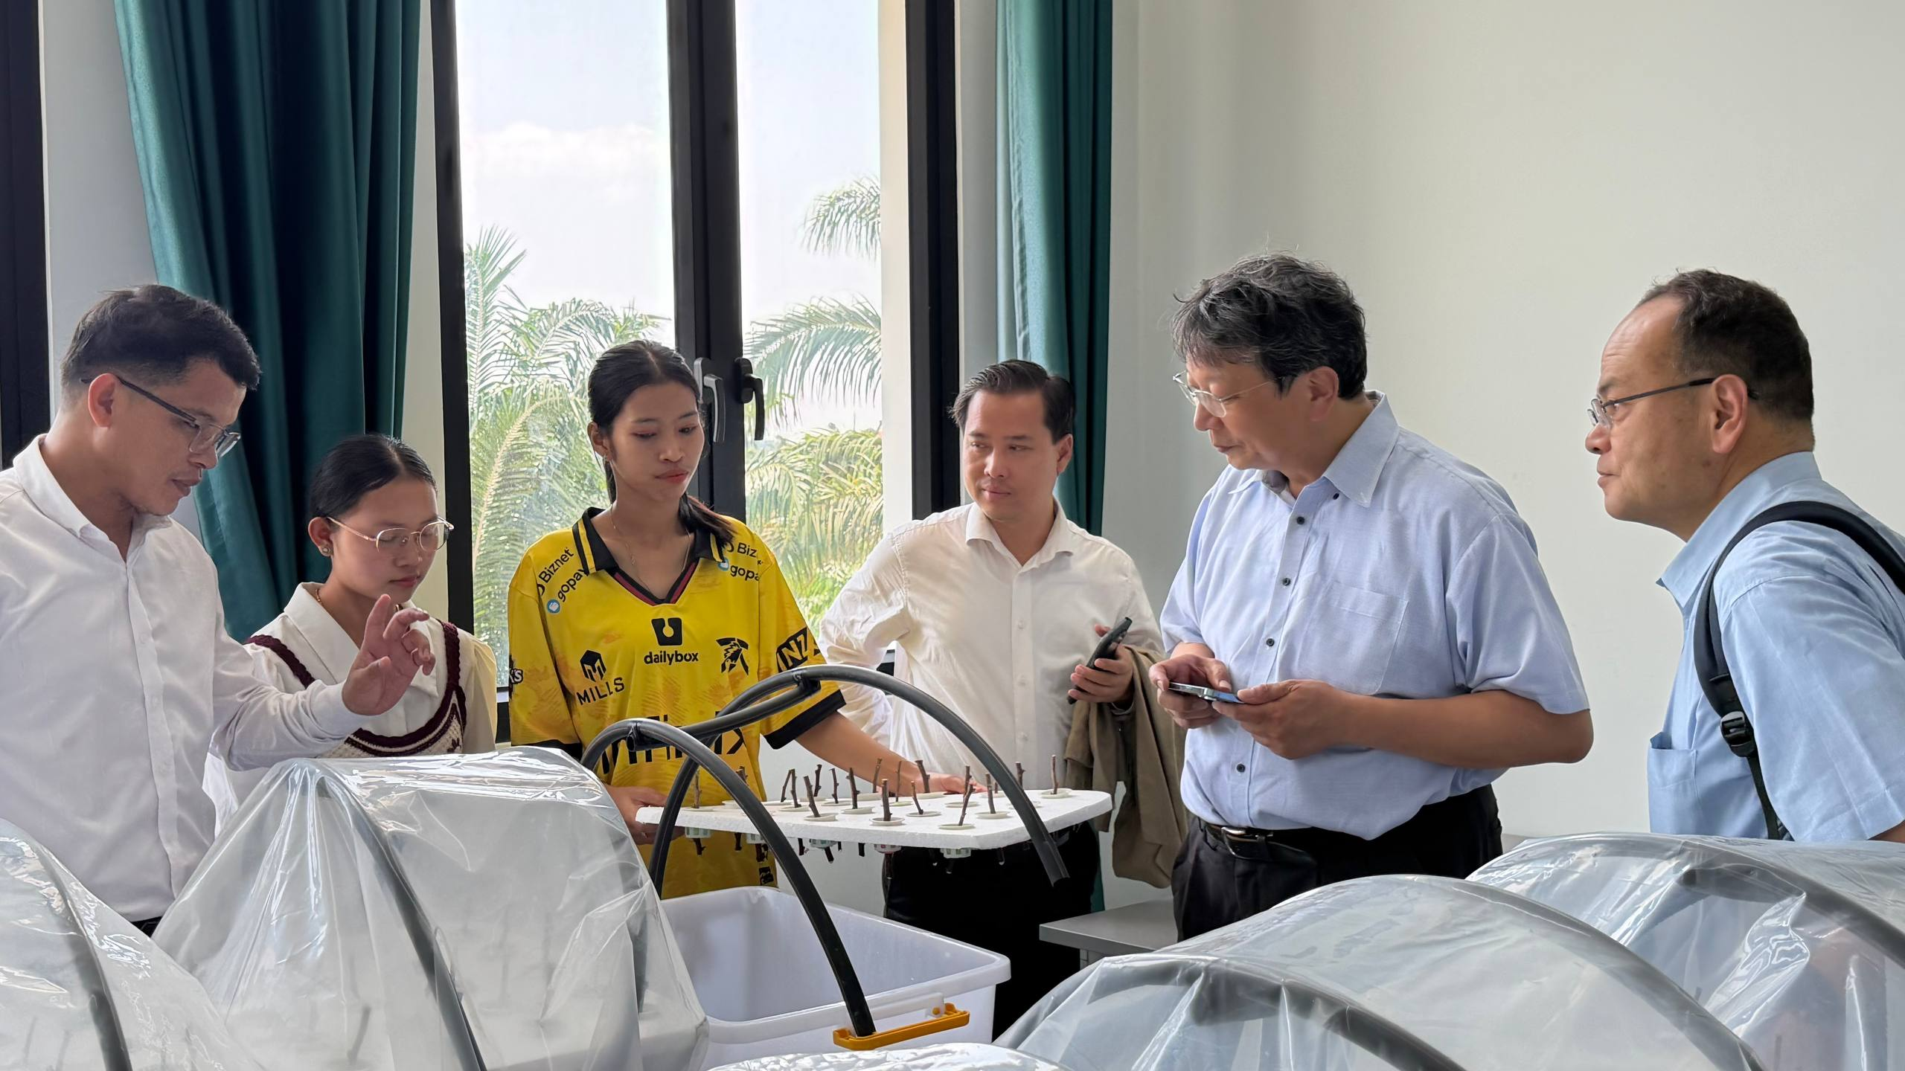
Methods
Aeroponic System
Tokunaga et al. (2019)

Slide 8
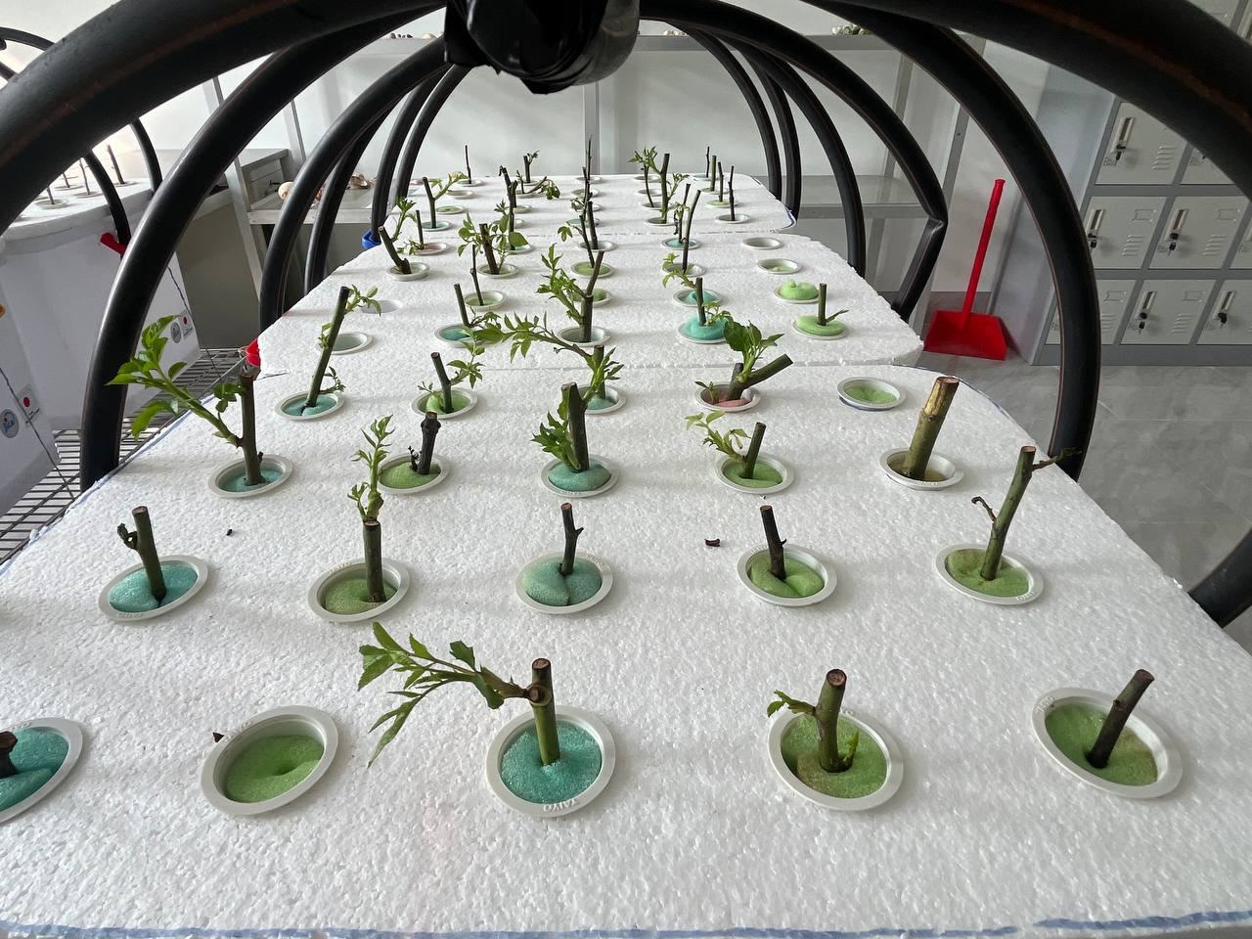
Results
At 3 weeks after planting.

Slide 9
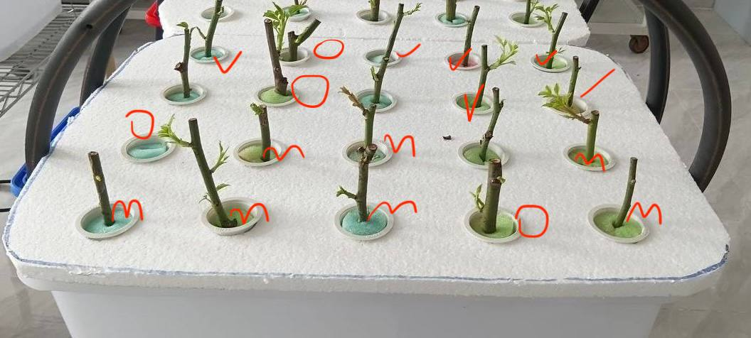
75%
65%
50%
P > 0.05
P > 0.05

Slide 10
Summary
Generated high-quality, curriculum-aligned MCQs using RAG and local LLMs.
Achieved over 90% question quality across evaluation criteria.
Average generation time: 2.49 s/question (95th percentile: 3.65 s).
Reduced hallucinations and improved semantic relevance through RAG.
Enabled privacy-preserving, low-latency Moodle assessment.

Slide 11
Laboratory-Based Education

Slide 12
Strategic Plans for LBE
How to involve students
How to motivate students
etc

Slide 13
Significant Activities for LBE
Any activities to enhance involvement of students
Create research environment
Regular progress meetings
etc

Slide 14
Significant Outcomes of LBE for Students
Change of students’ knowledge
Change of students’ motivation
Change of students’ skills in communication, problem solving
etc

Slide 15
General Outcomes of LBE
Lecturers
Environment
Cleanness
etc

Slide 16
Difficulties

Slide 17
Requests and Suggestions
Research Grant for next year

Slide 18
Strategies on LBE (Future)

Slide 19
Summary
Young cuttings demonstrated better Survival Rates.
The maturity of the cutting (nodal position) did not have a statistically significant impact on the Shoot Length or Bud Number within this aeroponic system.
All three types of cuttings performed comparably in terms of vegetative growth metrics once survival was established.

Slide 20


